Slide 1
Introduction to Deep Learning
Xiaodong Yu
2019.07.09
Norfolk Data Science Meetup
Notes:
Not memtion
DT v.s. Deep!!!!!

Slide 2
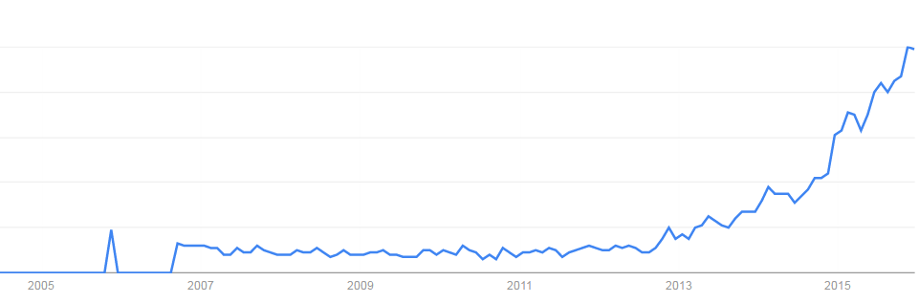
Deep learning attracts lots of attention.
Google Trends
Deep learning obtains many exciting results.
The talks in this evening
2007
2009
2011
2013
2015

Slide 3
Part 1: Overview
What is deep learning?
What is the relationship between deep learning and traditional machine learning algorithms, especially neural networks?
Why did it “suddenly” become so popular in recent years?
What are the secret weapons that make it so successfully in some domain?
What types of problems are particularly suitable for DL and what are not?
What is the limitation of DL?
What tools or frameworks of DL are ready to use?
If I am interested in DL, where I can find good tutorials and how I can study it by myself?
Notes:
What people already knew in 1980s

Slide 4
Q1 & Q2
What is deep learning?
What is the relationship between deep learning and traditional machine learning algorithms, especially neural networks?
AI
Machine learning
Deep Learning
Neural Networks
Deep Learning = Neural Network + deep architecture
More than one hidden layer

Slide 5
Q3 & Q4
Why did it “suddenly” become so popular in recent years?
What are the secret weapons that make it so successfully in some domain?
Short Answer:
Deep learning is NOT a brand new algorithm:
The history of neural network can be traced back to half century ago.
Perceptron was proposed by Rosenblatt in 1958
The first DL architecture has been designed in late 1990’s:
LeNet (1998)
The success of DL in the recent years can be credit to
Algorithm
Big data
Computing power

Slide 6
Q5 & Q6
What types of problems are particularly suitable for DL and what are not?
What is the limitation of DL?
Short Answer:
Deep learning is more suitable for domains where we can obtain large amount of data:
Computer vision:
Face recognition
Object recognition and detection
Speech recognition
Natural language processing
Social media
DL will not work well for problems:
Lack training data
Anything that requires reasoning, long-term planning, and algorithmic-like data manipulation, is out of reach for deep learning models

Slide 7
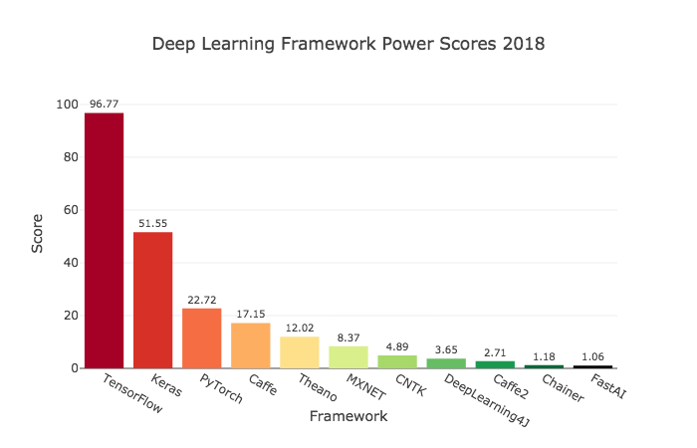
Q7
What tools or frameworks of DL are ready to use?
https://www.kaggle.com/discdiver/deep-learning-framework-power-scores-2018

Slide 8
Q8
If I am interested in DL, where I can find good tutorials and how I can study it by myself?
A:
The courses on MOOC (Massive Open Online Course) are usually very friendly to beginners:
https://www.coursera.org/specializations/deep-learning
https://www.deeplearning.ai/
https://www.udacity.com/course/deep-learning-nanodegree--nd101
https://www.edx.org/course?search_query=deep+learning
More serious learners can go to Stanford University website (https://cs230.stanford.edu/) to check out the lecture videos and notes of Deep Learning course for their undergraduates.
Researchers can see the most recent development in this field in international conferences such as CVPR, ICML, NeurIPS, etc.:

Slide 9
Part 2: from NN to DL
Brief introduction to Neurol Networks
Why deep?
Recipe to DL

Slide 10
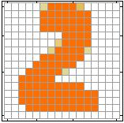
Example Application
Handwriting Digit Recognition
Machine
“2”
Notes:
“Hello world” for deep learning
Data: http://yann.lecun.com/exdb/mnist/

Slide 11
Handwriting Digit Recognition
Input
Output
y₁
is 1
0.1
y₂
is 2
0.7
The image is “2”
……
……
……
y₁₀
0.2
is 0
16 x 16 = 256
Ink → 1
No ink → 0
Each dimension represents the confidence of a digit.
Notes:
The same for even more complex tasks.

Slide 12
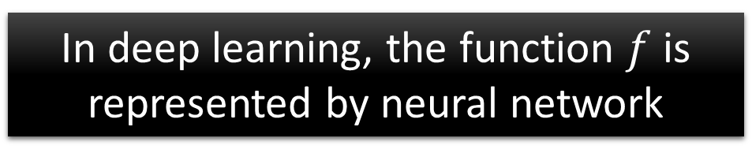

Example Application
Handwriting Digit Recognition
y₁
Machine
y₂
“2”
……
……
y₁₀
$$f:R^{256}→R^{10}$$
In deep learning, the function $f$ is represented by neural network

Slide 13

Element of Neural Network
Neuron
$$f:R^{K}→R$$
…
Activation function
weights
bias
Notes:
sigmoid

Slide 14
Neural Network
neuron
Input
Layer 1
Layer 2
Layer L
Output
……
y₁
……
y₂
……
……
……
……
……
……
y_{M}
Input Layer
Output Layer
Hidden Layers
Deep means many hidden layers
Notes:
Fully Connected Feedforward Network
You can always connect the neurons in your own way.
“+” is ignored
Each dimension corresponds to a digit (10 dimension is needed)

Slide 15


Neural Network
……
y₁
W¹
W²
W^{L}
……
y₂
b¹
b²
b^{L}
……
……
……
……
……
x
a¹
a²
y
……
y_{M}
y
x
Using parallel computing techniques to speed up matrix operation
$$=f\left( \right)$$
W^{L}
…
W²
W¹
x
b¹
b²
…
b^{L}
+
+
+
$$σ\left( \right)$$
$$=σ\left( \right)$$
$$σ\left( \right)$$
x
Notes:
Draw it?

Slide 16


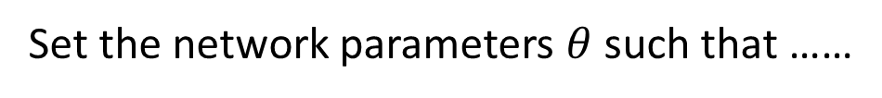
How to set network parameters
$$θ=\left\{W^{1},b^{1},W^{2},b^{2},⋯W^{L},b^{L}\right\}$$
……
y₁
is 1
0.1
……
y₂
0.7
is 2
Softmax
……
……
……
……
y₁₀
is 0
0.2
16 x 16 = 256
Ink → 1
No ink → 0
Set the network parameters $θ$ such that ……
Input:
How to let the neural network achieve this
y₁ has the maximum value
Input:
y₂ has the maximum value

Slide 17








Training Data
Preparing training data: images and their labels
“5”
“0”
“4”
“1”
“9”
“2”
“1”
“3”
Using the training data to find the network parameters.

Slide 18

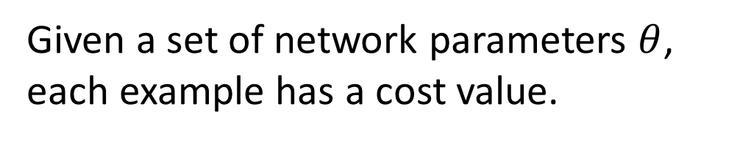
Cost
Given a set of network parameters $θ$, each example has a cost value.
“1”
……
y₁
0.2
1
……
y₂
0
0.3
……
……
……
Cost
……
……
……
y₁₀
$$L(θ)$$
0
0.5
target
Cost can be Euclidean distance or cross entropy of the network output and target
Notes:
With softmax, the summation of all the ouputs would be one.
Can be considered as probability if you want ……

Slide 19
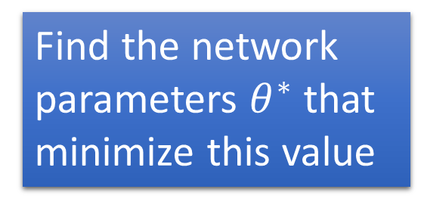


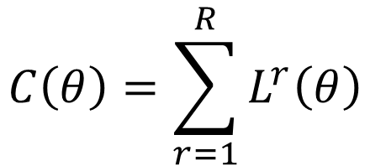






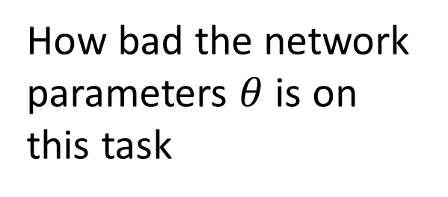
Total Cost
For all training data …
Total Cost:
NN
$$C\left(θ\right)=\sum_{r=1}^{R}{L^{r}\left(θ\right)}$$
x¹
y¹
$${\hat{y}}^{1}$$
$$L^{1}\left(θ\right)$$
x²
NN
y²
$${\hat{y}}^{2}$$
How bad the network parameters $θ$ is on this task
$$L^{2}\left(θ\right)$$
x³
NN
y³
$${\hat{y}}^{3}$$
$$L^{3}\left(θ\right)$$
……
……
……
……
Find the network parameters $θ^{∗}$ that minimize this value
x^{R}
NN
y^{R}
$${\hat{y}}^{R}$$
$$L^{R}\left(θ\right)$$
Notes:
Randomly picked one
Two approaches update the parameters towards the same direction, but stochastic is faster!
Better!

Slide 20
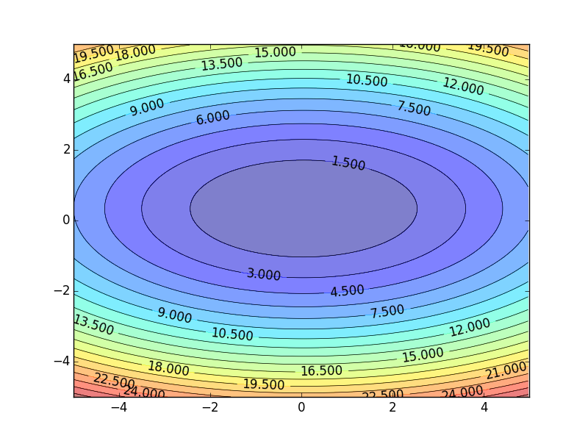
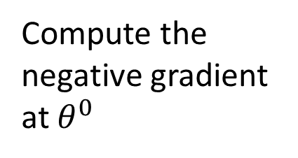

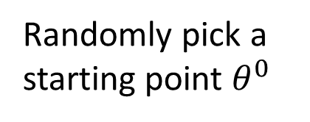
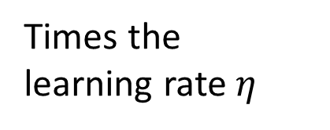








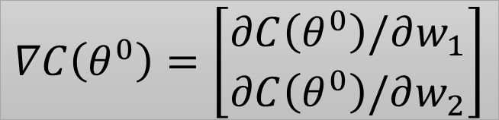
Gradient Descent
Assume there are only two parameters w₁ and w₂ in a network.
Error Surface
$$θ=\left\{w_{1},w_{2}\right\}$$
The colors represent the value of C.
Randomly pick a starting point $θ^{0}$
Compute the negative gradient at $θ^{0}$
$$w_{2}$$
$$θ^{∗}$$
$$−η∇C\left(θ^{0}\right)$$
$$−∇C\left(θ^{0}\right)$$
$$−∇C\left(θ^{0}\right)$$
Times the learning rate $η$
$$∇C\left(θ^{0}\right)=\left[\begin{matrix}∂C\left(θ^{0}\right)/∂w_{1} \\ ∂C\left(θ^{0}\right)/∂w_{2}\end{matrix}\right]$$
$$θ^{0}$$
$$−η∇C\left(θ^{0}\right)$$
$$w_{1}$$
Notes:
Eta
人站在 ｔｈｅｔａ０ 環顧四周 看看哪裡最低，那個方向就是 ｇｒａｄｉｅｎｔ

Slide 21






Gradient Descent
Eventually, we would reach a minima …..
Randomly pick a starting point $θ^{0}$
Compute the negative gradient at $θ^{0}$
$$θ^{2}$$
$$−η∇C\left(θ^{2}\right)$$
$$−η∇C\left(θ^{1}\right)$$
$$w_{2}$$
$$−∇C\left(θ^{2}\right)$$
$$−∇C\left(θ^{1}\right)$$
$$θ^{1}$$
$$−∇C\left(θ^{0}\right)$$
Times the learning rate $η$
$$θ^{0}$$
$$−η∇C\left(θ^{0}\right)$$
$$w_{1}$$

Slide 22
Deeper is Better?
Layer X Size | Word Error Rate (%) | Layer X Size | Word Error Rate (%)
1 X 2k | 24.2
2 X 2k | 20.4
3 X 2k | 18.4
4 X 2k | 17.8
5 X 2k | 17.2 | 1 X 3772 | 22.5
7 X 2k | 17.1 | 1 X 4634 | 22.6
 |  | 1 X 16k | 22.1
Not surprised, more parameters, better performance
Seide, Frank, Gang Li, and Dong Yu. "Conversational Speech Transcription Using Context-Dependent Deep Neural Networks." Interspeech. 2011.
Notes:
SWB
For a fixed number of parameters, a deep model is clearly better than the shallow one.

Slide 23
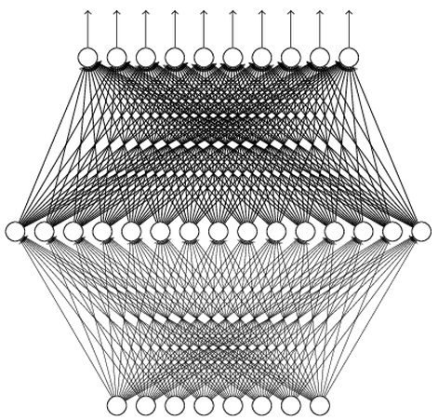
Universality Theorem
Any continuous function f
Can be realized by a network with one hidden layer
(given enough hidden neurons)
Reference for the reason: http://neuralnetworksanddeeplearning.com/chap4.html
Why “Deep” neural network not “Fat” neural network?

Slide 24
Fat + Short v.s. Thin + Tall
The same number of parameters
Which one is better?
……
……
……
Shallow
Deep

Slide 25
Fat + Short v.s. Thin + Tall
Layer X Size | Word Error Rate (%) | Layer X Size | Word Error Rate (%)
1 X 2k | 24.2
2 X 2k | 20.4
3 X 2k | 18.4
4 X 2k | 17.8
5 X 2k | 17.2 | 1 X 3772 | 22.5
7 X 2k | 17.1 | 1 X 4634 | 22.6
 |  | 1 X 16k | 22.1
Seide, Frank, Gang Li, and Dong Yu. "Conversational Speech Transcription Using Context-Dependent Deep Neural Networks." Interspeech. 2011.

Slide 26
Why Deep?
Deep → Modularization
Classifier 1
Girls with
long hair
Long hair girl
Long hair girl
Long hair girl
Long hair girl
Classifier 2
Boys with
long hair
Long hair boy
Image
weak
Little examples
Classifier 3
Girls with
short hair
Short hair girl
Short hair girl
Short hair girl
Short hair girl
Classifier 4
Boys with short hair
Short hair boy
Short hair boy
Short hair boy
Short hair boy
Notes:
Programming -> all in main -> so long and bad
-> function -> shorter

Slide 27
Why Deep?
can be trained by little data
Deep → Modularization
Classifier 1
Girls with
long hair
Boy or Girl?
Classifier 2
Boys with
long hair
Image
Basic
Classifier
fine
Little data
Classifier 3
Girls with
short hair
Long or short?
Classifier 4
Boys with short hair
Sharing by the following classifiers as module

Slide 28
Why Deep?
Deep → Modularization
……
The modularization is automatically learned from data.
……
……
……
……
……
……
The most basic classifiers
Use 1st layer as module to build classifiers
Use 2nd layer as module ……
Notes:
Need less data!!!!!

Slide 29
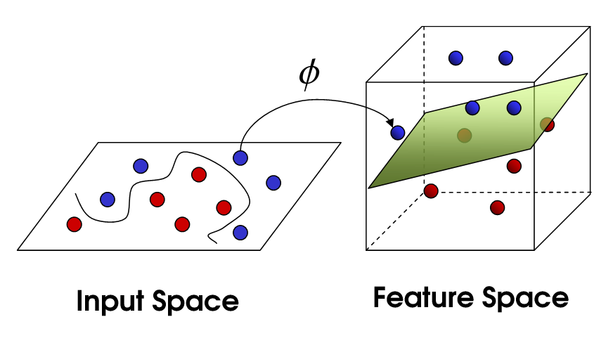


Hand-crafted
kernel function
SVM
Apply simple classifier
Source of image: http://www.gipsa-lab.grenoble-inp.fr/transfert/seminaire/455_Kadri2013Gipsa-lab.pdf
Deep Learning
simple classifier
Learnable kernel
$$φ\left(x\right)$$
……
y₁
$$x$$
……
y₂
…
…
…
…
…
……
y_{M}

Slide 30
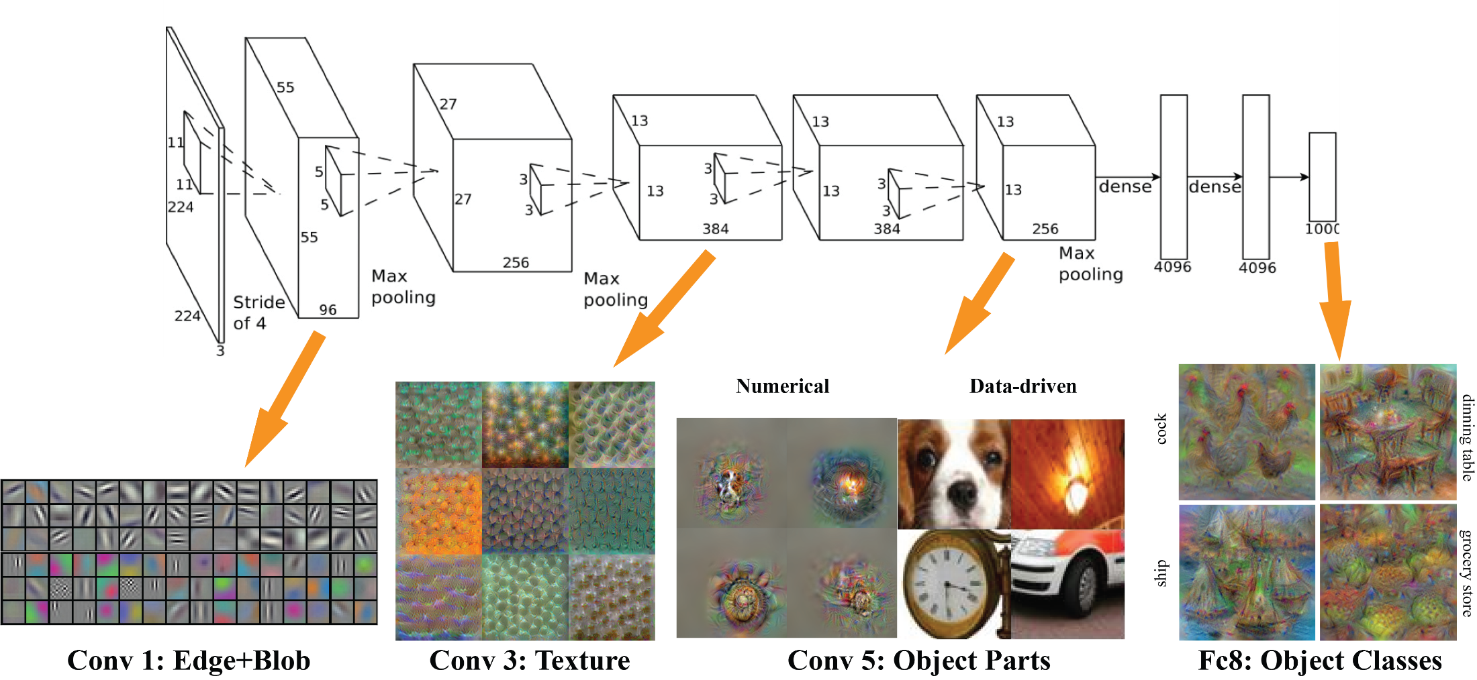
Visualization of hidden layers of a Convolutional Neural Network
https://www.cc.gatech.edu/~hays/compvision/proj6/

Slide 31
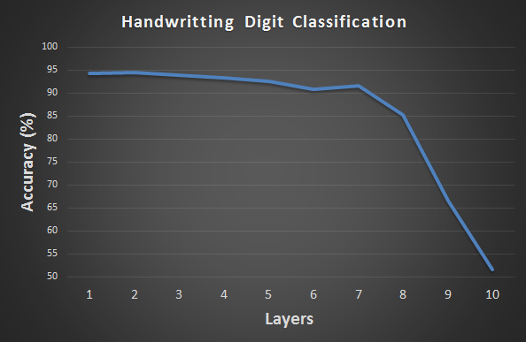
Hard to get the power of Deep …
Before 2006, deeper usually does not imply better.

Slide 32
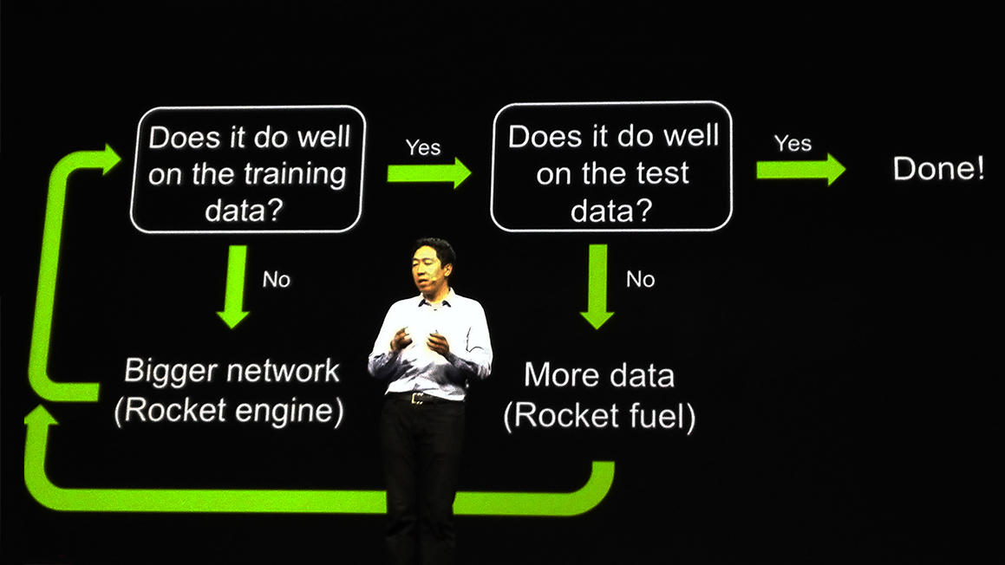
Recipe for Learning
http://www.gizmodo.com.au/2015/04/the-basic-recipe-for-machine-learning-explained-in-a-single-powerpoint-slide/
Notes:
今年四月的 GTC

Slide 33
Recipe for Learning
Don’t forget!
overfitting
Modify the Network
Preventing
Overfitting
Better optimization Strategy
http://www.gizmodo.com.au/2015/04/the-basic-recipe-for-machine-learning-explained-in-a-single-powerpoint-slide/
Notes:
Last one is on training set
Sometimes students ask

Slide 34
Recipe for Learning
Modify the Network
Better optimization Strategy
Prevent Overfitting
New activation functions, for example, ReLU or Maxout
Adaptive learning rates
Dropout

Slide 35

Email: dawnrain.yu@gmail.com
https://www.linkedin.com/in/yuxiaodong/

